Slide 1


(SCTP) Advanced Professional Certificate
Data Science and AI

Slide 2

3.4 Supervised Learning - Advanced

Slide 3
Module Overview
3.1 Introduction to Machine Learning
3.2 Probability and Statistics for Machine Learning
3.3 Supervised Learning
3.4 Supervised Learning - Advanced
3.5 Unsupervised Learning
3.6 Time Series Data & Forecasting
3.7 Neural Network & Deep Learning
3.8 Computer Vision (CV)
3.9 Natural Language Processing (NLP)
3.10 Transformers, Attention & GenAI

Slide 4
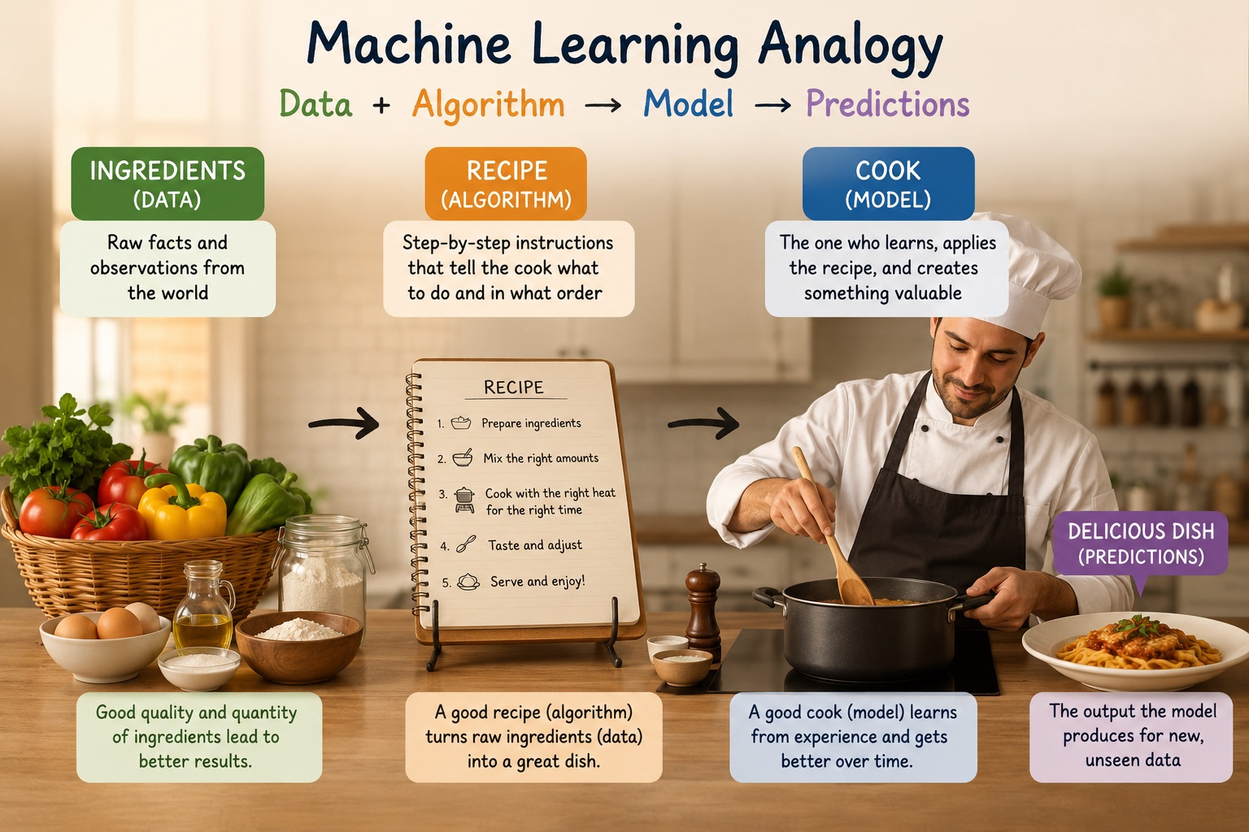

Slide 5
Module 3 · Machine Learning & GenAI
L03
Trees & Ensembles
Sarah’s week of improving the L03 model
Notes:
Welcome to Lesson 3 — Supervised Learning Foundations. This is the most production-relevant lesson in the course. Today: preprocessing, training, evaluation, and the business-aware threshold choice. Same 3-hour structure as L01 and L02 — ~90 min slides + ~90 min hands-on with three slim notebooks.

Slide 6
Where We Left Off
Marcus, end of L03:
""This is the first model we own. But we're hitting capacity at 200 calls.
Can you squeeze MORE recall without more false positives? Try those tree-based models."
What Sarah has now
📂Same churn dataset | 10,000 NorthStar customers — story continuity from L03
🎯Bar to beat | L03 logistic regression at threshold 0.25 → F1 ≈ 0.286
🛠 New tools | Decision trees, bagging (Random Forest), boosting (Gradient Boosting), GridSearchCV
🏁 Decision point | Friday: pick ONE model to recommend for production
Notes:
Quick recap. End of L02, Marcus asked Sarah: 'can you train your own model on NorthStar data?' That brief is this week's work. Sarah received a new dataset: 10,000 customers, 11 features, target = churned. By Friday: a working classifier + honest metrics + a recommendation on how to use it.

Slide 7
What did you learn in Pre-Class?

Slide 8
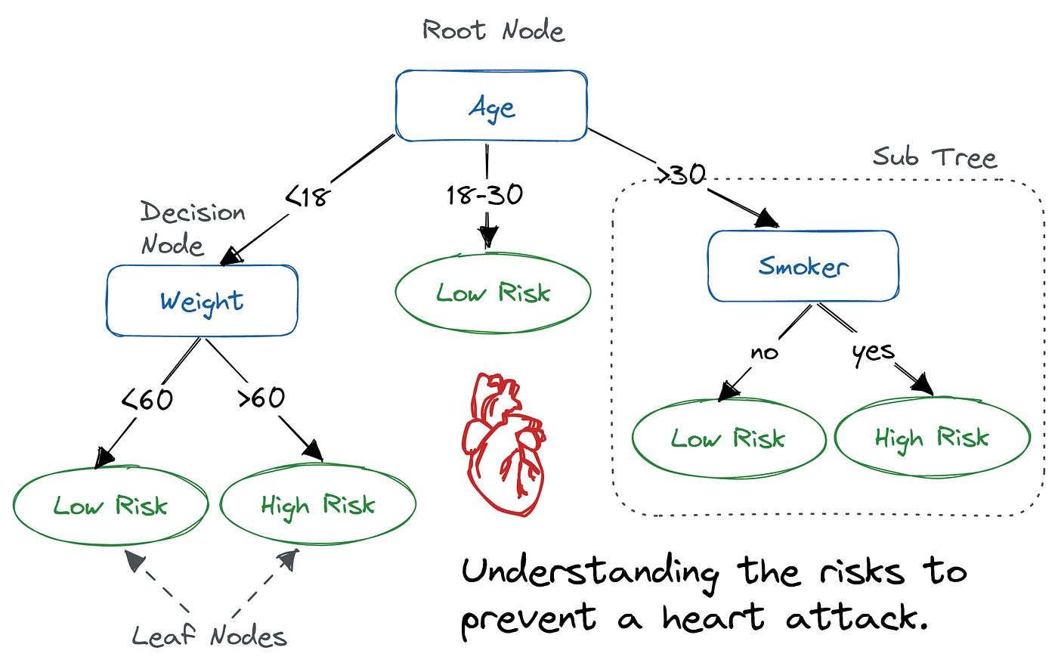
Decision Tree

Slide 9
One Tree Isn’t Enough
Either overfits or underfits — never both right
Deep tree (full depth)
Shallow tree (depth 3)
Training accuracy: 1.000
Training accuracy: 0.880
Test accuracy: 0.799
Test accuracy: 0.880
Test F1: 0.183
Test F1: 0.000
20-point train/test gap.
The tree memorised every training example.
Low bias, HIGH variance.
Diagnosis: OVERFITS.
No train/test gap...
...because the tree just predicts 'stayed' for everyone.
HIGH bias, low variance.
Diagnosis: UNDERFITS.
The fix: train MANY trees on different subsets, then AVERAGE → Random Forest.
Notes:
BUT a single tree is rarely the answer. Grow it deep and it memorises training data perfectly — overfits. Grow it shallow and it can't capture the patterns — underfits. Neither extreme works. The fix is ENSEMBLES: train many trees and combine them.

Slide 10
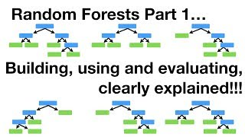

Slide 11
Bagging — The Random Forest Idea
Train many trees on slightly different data, then average
Two sources of variation between trees:
1. Bootstrap sampling (rows)
2. Feature subsampling (cols)
Each tree trains on a random sample of N rows drawn WITH replacement.
~63% of rows appear at least once.
~37% are ‘out of bag’ — free validation set.
At each split, the tree considers ONLY a random subset of features.
Default for classification: sqrt(n_features).
This is the trick that DECORRELATES the trees.
Why both matter
Without feature subsampling, every tree picks the SAME top split and the ensemble is N copies of nearly the same model.
Feature subsampling forces trees to specialise — that's what makes averaging genuinely reduce variance.
Proof: turn feature subsampling OFF (max_features=None) and watch RF performance get WORSE.
Notes:
Bagging — Bootstrap Aggregating. The core idea behind Random Forest. Two sources of variation between trees: bootstrap sampling of the ROWS, and random subsampling of FEATURES at each split. Together, they force the trees to specialise so averaging genuinely reduces variance.

Slide 12
Boosting — Sequential Error Correction
Each new tree fits what the ensemble got wrong
The algorithm:
1. Initial prediction = mean of y_train
2. Compute residuals = y - prediction
3. Train a SMALL tree to predict the residuals
4. Update: prediction = previous + learning_rate × tree_prediction
5. Repeat from step 2 (200-500 rounds typical)
The conceptual leap from Random Forest
"Random Forest is N independent guesses, averaged. Boosting is N corrections, stacked."
Notes:
Boosting is the OTHER big ensemble idea. Random Forest trains trees in PARALLEL and averages. Boosting trains them SEQUENTIALLY, where each new tree fits the ERRORS of the previous ensemble. This is what wins Kaggle.

Slide 13
Interpretability vs Accuracy
The classic trade-off — pick your seat carefully
Interpretability ◄──────────────────────────────────────────────► Accuracy
Logistic
Regression
Decision
Tree
Random
Forest
Gradient
Boosting
Neural
Network
Coefficients are direct interpretations
Visualisable as a flowchart
Feature importance still intuitive
SHAP values needed for individual predictions
Mostly opaque (saliency, attention, etc.)
For NorthStar:
Gradient Boosting strikes the right balance — feature importance is reportable to Marcus, F1 beats RF.
Notes:
A classic tradeoff. The most accurate model is usually the least interpretable. Logistic regression is the most explainable; deep neural networks the least. Trees sit in the middle — feature importance is intuitive even when the underlying ensemble is complex.
Gradient Boosting models are highly accurate but sit further to the right on the "black box" side of the interpretability scale. Unlike a simple Logistic Regression (where you can just look at the weights) or a single Decision Tree (where you can follow the flowchart), a Gradient Boosting model combines hundreds of trees. You can't just "look" at it to understand why it made a specific decision. SHAP stands for SHapley Additive exPlanations. It is a mathematical method used to break down and explain individual predictions.
Here is how it works:
1. The "Team Game" Analogy
SHAP is based on cooperative game theory. Imagine your model's prediction is a game, and your features (e.g., Age, Tenure, Usage) are the players working together to achieve a score (the prediction). SHAP calculates the exact "payout" or contribution each player made to the final score, ensuring it's distributed fairly.
2. How it looks in practice
If your NorthStar GB model predicts that a specific customer has an 85% probability of churning, a SHAP explainer will break down exactly how the model arrived at 85% from the average baseline:
Base (Average) Churn Risk: 20%
+ 40% (Because Tenure_Months < 3)
+ 35% (Because Recent_Returns > 5)
- 10% (Because Is_Premium_Member = Yes)
Final Prediction = 85%
3. Local vs. Global Interpretability
Local (Individual): SHAP's primary superpower is telling you exactly why one specific row of data got the prediction it did (which is what your slide means by "SHAP values needed for individual predictions").
Global (Overall): By averaging the absolute SHAP values across all your customers, you can generate a highly accurate "Feature Importance" chart that tells you which variables drive the model's behavior overall.
In short, SHAP is the tool you use to safely explain a complex Gradient Boosting model to stakeholders like Marcus, proving that the model isn't just making arbitrary guesses.

Slide 14
Bridge to L05
Marcus, after Friday’s presentation:
"Ship the Random Forest model. Now — what about the customers who DON'T churn but also don't log in for a year?
Can we find natural CLUSTERS of customer behaviour? Without labels?"
Lesson 5 — Unsupervised Learning
k-means · hierarchical clustering · DBSCAN · anomaly detection · dimensionality reduction (PCA)
No target column. Just data and structure.
Before L05 — finish the Kaggle competition in notebooks/assignment.ipynb.
Notes:
Marcus's new question — 'can you train your OWN model on NorthStar data?' — is the engine of Lesson 3. L03 introduces the supervised learning workflow proper: train/test split, preprocessing, linear and logistic regression, and the metrics that tell you whether your model is good. Come ready to build your first model from scratch.

Slide 15
See You in L05
Unsupervised Learning — k-means · hierarchical clustering · anomaly detection · PCA
Before then: finish the Kaggle competition in notebooks/assignment.ipynb
And consider XGBoost or LightGBM in optional_extensions.ipynb
Notes:
Closing. L05 next — unsupervised learning, clustering, dimensionality reduction. Before then: Kaggle competition + banking fraud exercises.

